Slide 1
Docker Kubernetes Training
21-23 October, 2019
Albert Anthony

Slide 2
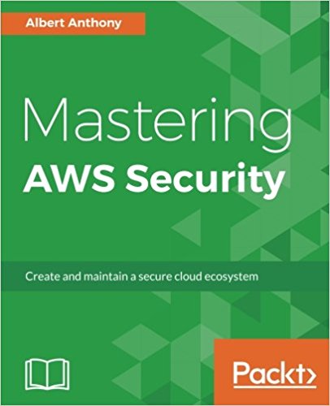
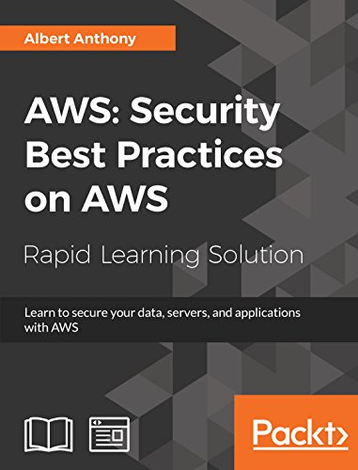
Introductions
Founder of Loves Cloud (www.loves.cloud) & PowerBoard (www.powerboard.in)
Trainer & Consultant
Containers, DevOps, Cloud & Serverless
Author – Mastering AWS Security
Author – AWS Security Best Practices

Slide 3
Setting Expectations
Topics and Labs
Docker Hands-On (6 Labs)
Kubernetes Hands-On (9 Labs)
15 Hands-on Labs

Slide 4
Pre-requisites
Putty/GitBash on Laptop to Connect to Remote Server
Internet – HotSpot to Connect to Remote Server
Resources:
GitHub Account
Docker Hub Account

Slide 5
Training Methodology
Less theory, more labs
Fully functional environment for all participants
Servers and software pre-installed
Hands-on labs for all topics
Team and individual assignments
Best Practices
Lab instructions document
Labs similar to real projects
All training material to be shared with participants
Feedback, day 1 and day 3

Slide 6
Training Schedule – Day 1
Setting Expectations
Access your own workstation on cloud
Docker
Docker Overview
Dockerfile
Docker Hub
Kubernetes Overview
Kubernetes Architecture

Slide 7
Training Schedule – Day 2
Kubernetes Objects
Namespaces
Pods
Service
Deployments Etc.
Run Dockerized .Net apps on Kubernetes Cluster
Persistent Storage
Health Checks
Kubernetes Secrets

Slide 8
Training Schedule – Day 3
Ingress
Horizontal Pod Autoscaler
Monitoring Kubernetes Cluster
Putting it all Together
One lab to Cover All Concepts
Demo – Fully Automated CI/CD Pipeline
Dockerize an app
Deploy to Kubernetes Cluster

Slide 9
Download Lab Instructions
https://github.com/albertlovescloud/delltraining

